Slide 1

Computer Vision Based Touchless Device Control
Theme- Goal 10: Reduced Inequalities (Accessibility for motor-impaired), Goal 3: Good Health and Well-being (Touchless hygiene)
Category- Software
Group No – 01
Group Members- Shreyas Mhatre, Sanidhya Pandey, Kalash Pandey, Om Brahmavale
Guide- Prof. Priyanka Patil

Slide 2
Outline
Introduction
Literature Survey
Limitations of existing systems
Problem statement and Objectives
Proposed Methodology
Experimental Setup
Implementation
Results & Analysis
Conclusion and Future work
References

Slide 3
Introduction
Human–Computer Interaction (HCI) traditionally relies on physical input devices such as mouse and keyboard.
These devices require fine motor control and direct physical contact.
Rapid growth of digital interfaces in healthcare, public kiosks, education, and enterprise systems.
Emergence of Computer Vision enables touchless and intelligent interaction models.
Need for inclusive and hygienic interaction technologies in modern digital ecosystems.

Slide 4
Introduction
Motivation:
SDG 10 – Reduced Inequalities
Promote digital accessibility for motor-impaired individuals.
Enable inclusive participation in digital environments.
SDG 3 – Good Health & Well-being
Reduce contact-based transmission risks.
Encourage hygienic, touch-free digital interaction.
Objectives:
Integrate face tracking and hand gesture recognition in a hybrid model
Provide an accessible and hygienic alternative to traditional input devices

Slide 5
Literature Survey
Author & Year | Techniques / Method Used | Dataset Used | Key Results | Limitations
Drouard et al., 2016 | Partially-Latent Mixture of Linear Regressions (PLML), Face bounding box-based head pose estimation from single RGB image | Public head pose datasets (e.g., AFLW, BIWI) | Robust head pose estimation with improved regression accuracy; suitable for real-time orientation prediction | Focused only on head pose; no gesture integration; computational complexity; not optimized for lightweight multimodal HCI
Kodali et al., 2023 | OpenCV, MediaPipe hand landmarks, Haar Cascade face detection, Pycaw audio control, Rule-based gesture classification | Custom real-time webcam data | Real-time gesture-based volume control and virtual mouse; integrated facial authentication | Sensitive to lighting and occlusion; no adaptive learning; limited multimodal capability

Slide 6
Literature Survey
Author & Year | Techniques / Method Used | Dataset Used | Key Results | Limitations
Patle et al., 2025 | Multimodal system (Gesture + Voice + Gaze), MediaPipe hand tracking, Vosk/Whisper speech recognition, Webcam-based gaze tracking, Context-aware modality switching, Edge deployment | Lab-based case studies (Healthcare, Classroom, Industrial Control Room, VR environments) | Adaptive modality switching based on environment; real-time multimodal interaction; privacy-preserving on-device processing; improved hygienic interaction | Requires calibration (especially gaze); affected by lighting and ambient noise; hardware resource constraints; limited large-scale deployment
Hema et al., 2025 | OpenCV + MediaPipe (21 hand landmarks), HSV color segmentation, Euclidean distance thresholding, Virtual mouse, Air canvas, PPT controller | 50 participants performing 20 predefined gestures each | 93% accuracy under optimal lighting 89% accuracy in low light; real-time responsiveness | Performance decreases in poor lighting; occlusion sensitivity; mainly static gesture recognition; no facial interaction integration

Slide 7
Limitations of existing Systems
Sensitive to environmental conditions (low light, noise, occlusion).
Performance degradation under poor lighting or crowded environments.
Require calibration (especially gaze-based systems).
High computational requirements for advanced models.
Hardware constraints on edge devices (thermal throttling, frame drops).
No integrated hybrid face + hand interaction in a unified framework

Slide 8
Problem statement and Objectives
Individuals with motor impairments often face significant barriers when interacting with digital systems that rely on keyboards, mice, and touchscreens. Similarly, public kiosks and shared interfaces depend on physical contact, increasing hygiene risks and limiting safe accessibility in real-world environments. Our hybrid touchless interaction system directly addresses this gap by offering a unified, computer vision-based platform that enables hands-free control through face and hand gestures, ensuring both accessibility for motor-impaired users and hygienic operation in public spaces.

Slide 9
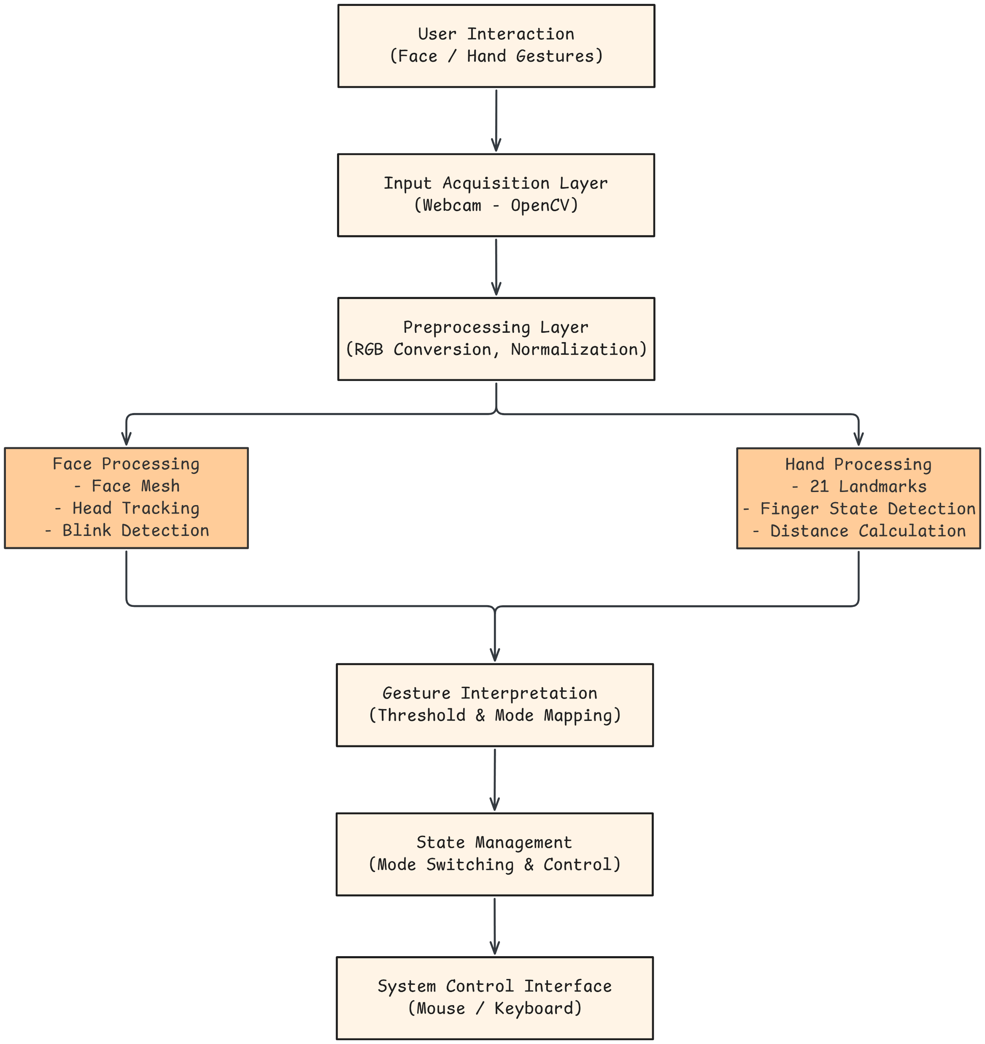
Proposed Methodology
Fig. 1. System Architecture

Slide 10
Proposed Methodology
Proposed Enhancements & Value Addition Over Existing Systems:
Hybrid Dual-Mode Architecture: Integrated Face (head movement + blink) and Hand gesture control in a unified framework instead of single-modality systems
Mode Isolation via Launcher: Separate execution of Face and Hand modules to reduce CPU load and prevent action conflicts.
Clutch / Pause Mechanism: Added control stabilization to prevent unintended cursor drift and improve precision for motor-impaired users.

Slide 11
Experimental Setup
Input/Dataset:
Real-time video input captured using standard webcam
No pre-trained dataset dependency (live landmark-based detection)
Performance Evaluation Parameters:
Latency: Real-time response without noticeable delay
Gesture Recognition Accuracy: Correct detection of finger states and blink events
Robustness: Performance under different lighting and background conditions

Slide 12
Experimental Setup
Software Technologies:
Python
OpenCV (Video Processing)
MediaPipe (Face & Hand Landmarks)
NumPy (Mathematical Computations)
PyAutoGUI (Cursor & System Control)
Hardware Setup:
Standard Laptop/Pc
Systems with Integrated Webcam

Slide 13
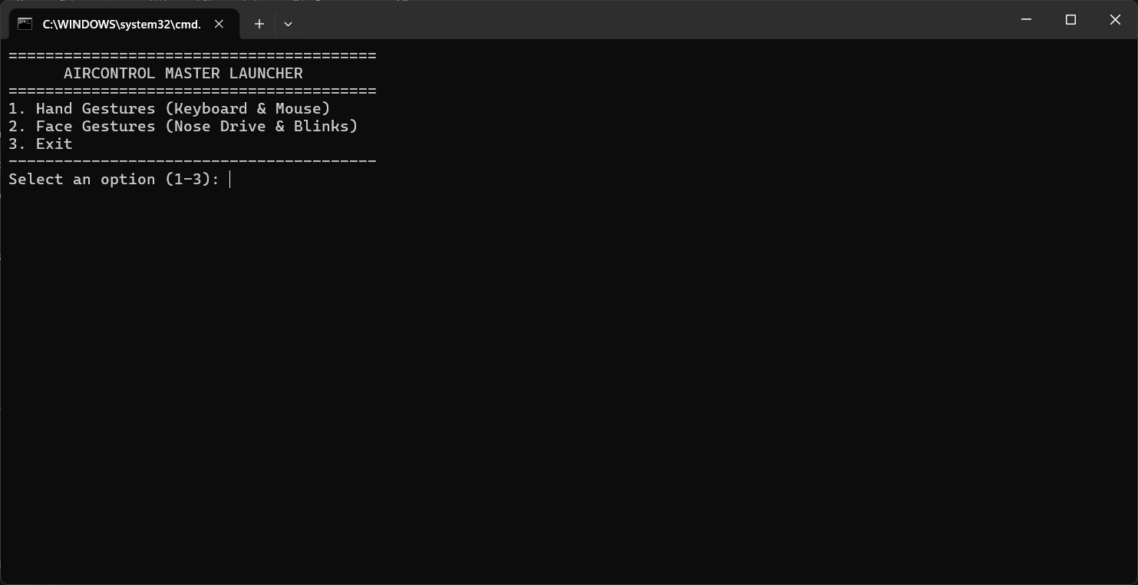
Implementation
Fig.2.1. Launcher

Slide 14

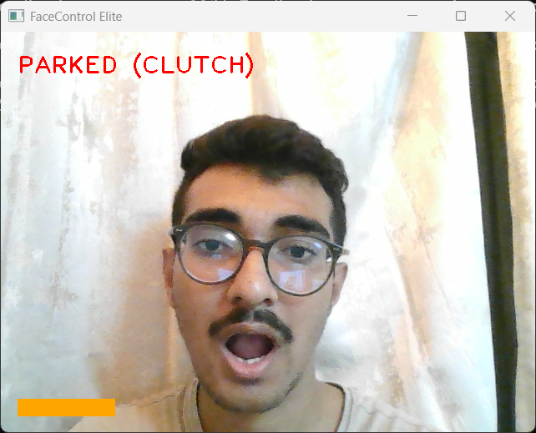
Implementation
Fig.2.2. Face Mouse Move State
Fig.2.3. Face Mouse Clutch State

Slide 15
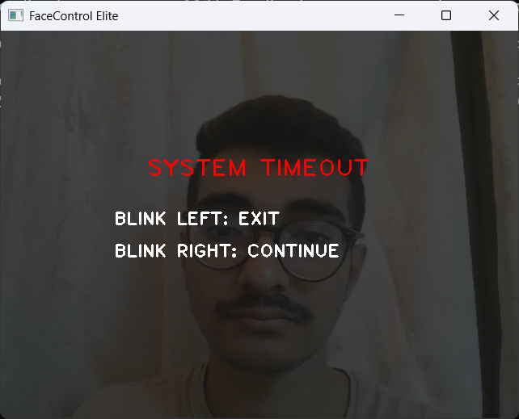
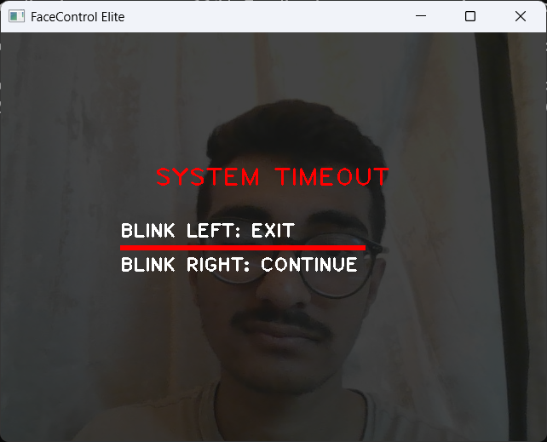
Implementation
Fig.2.4. System Exit Dialogue
Fig.2.5. System Exit Choice

Slide 16
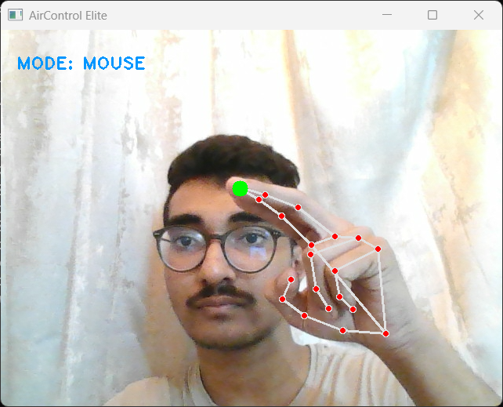
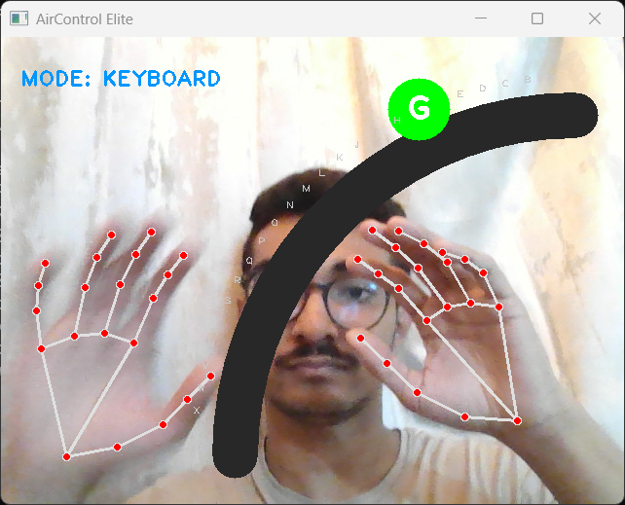
Implementation
Fig.2.6. Hands Mouse Mode
Fig.2.7. Alphabets Typing

Slide 17
Results & Analysis
System Performance:
Real-time gesture and face tracking achieved with stable frame processing.
Smooth cursor control using head movement and hand landmarks.
Reliable blink-based click and mouth-based clutch detection.
No cloud dependency – fully edge-based execution.
Functional Evaluation:
Accurate detection of finger states and gesture transitions.
Stable operation under normal indoor lighting conditions.
Reduced unintended cursor movement due to clutch/pause mechanism.

Slide 18
Conclusion
Successfully developed a hybrid touchless interaction system integrating Face and Hand gesture control.
Achieved real-time cursor movement, click actions, and virtual keyboard functionality without physical devices.
Implemented mouth-based clutch and pause mechanisms for improved control stability.
Fully edge-based execution ensures privacy, low latency, and practical real-world usability.
Future Scope:
Adaptive sensitivity calibration for different users.
Machine learning-based dynamic gesture recognition.
Deployment optimization for embedded kiosk systems.

Slide 19
References
[1] V. Drouard, R. Horaud, and S. De la Torre, “Robust Head Pose Estimation Using Partially-Latent Mixture of Linear Regressions,” arXiv preprint arXiv:1603.09732, 2016. [Online]. Available: https://arxiv.org/abs/1603.09732
[2] S. Kodali, G. Divya, B. Dharani, A. V. B. Prasad, and G. V. S. R. Raju, “Touch Less Computer Interaction and User Identification,” International Journal for Research Trends and Innovation (IJRTI), vol. 8, no. 4, pp. 239–249, Apr. 2023. [Online]. Available: https://www.ijrti.org/papers/IJRTI2304038.pdf

Slide 20
References
[3] B. Patle, R. Banothe, B. Kumbhare, and Y. Laxane, “The Future of Touchless Interfaces in Human-Computer Interaction,” International Journal of Advanced Research in Science, Communication and Technology (IJARSCT), vol. 5, no. 9, Mar. 2025, doi: 10.48175/IJARSCT-24626. [Online]. Available: https://doi.org/10.48175/IJARSCT-24626
[4] H. M. R., M. Mallesh, M. S., R. K., and N. D. Hegde, “Virtual Interaction System Using OpenCV for Touch-Free Human-Computer Interaction,” International Journal of Research Publication and Reviews (IJRPR), vol. 6, no. 5, pp. 14992–14998, May 2025. [Online]. Available: https://www.ijrpr.com/uploads/V6ISSUE5/IJRPR46777.pdf

Slide 21
Thank You...!!

